Slide 1
Weekly Report
2017741025 장재우
2017741052 최석원
2016741012 문석준
2017741021 김태겸

Slide 2
Index
1
Mecanum Wheel
2
Hardware Design 1
3
Hardware Design 2
4
Scenario

Slide 3
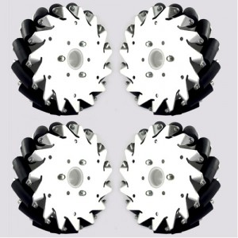
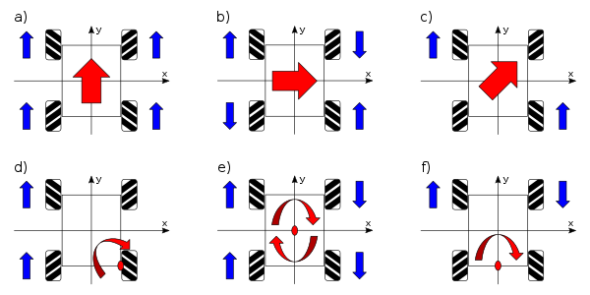
Mecanum Wheel
Movements to any directions
Easy to rotation in place

Slide 4
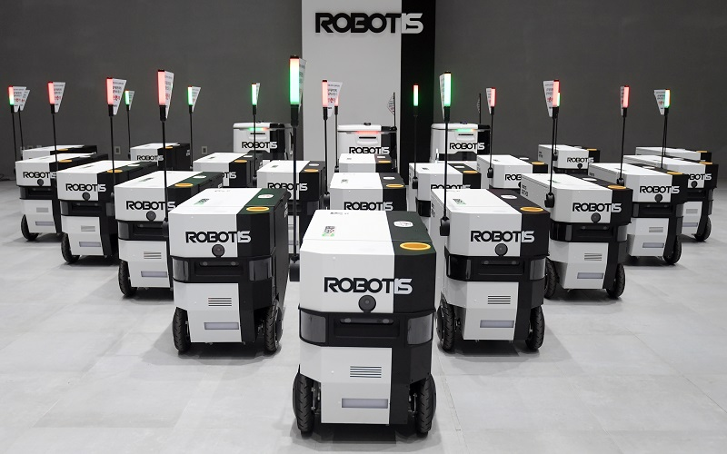
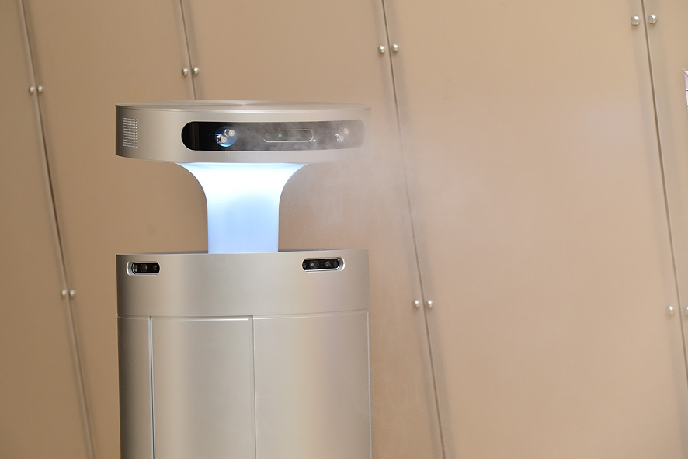
Hardware Design 1
Problem about existing robots
One robot, one purpose

Slide 5
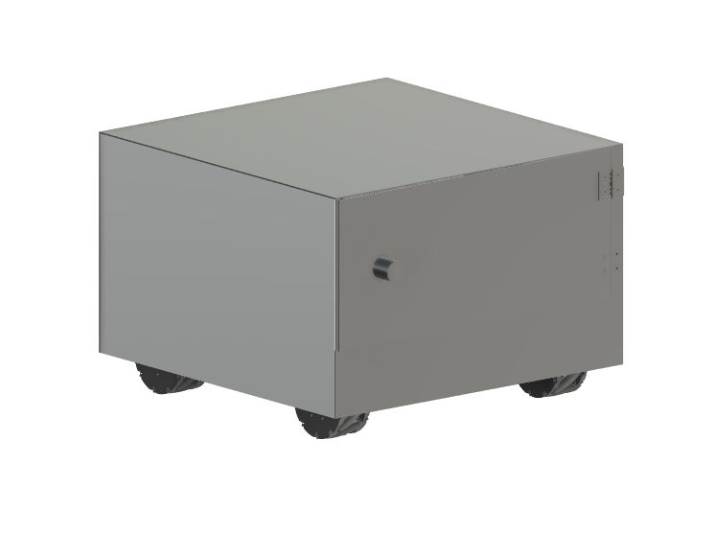
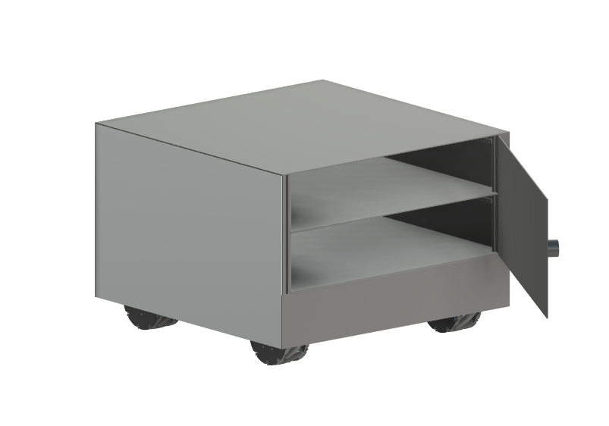
Hardware Design 1
Delivery + Disinfection = Focus on Multipurpose
Delivery
Food, paper or some packages
Separated container
Food
Package or paper(no food)
Disinfection
Air cleaner
Detect doorknob and spray disinfectant
Spray
+
Air cleaner
Spray
+
Air cleaner

Slide 6
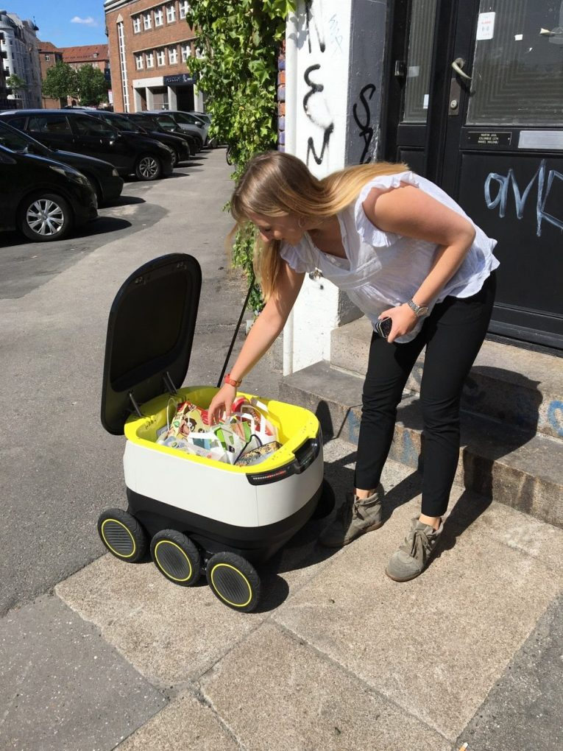
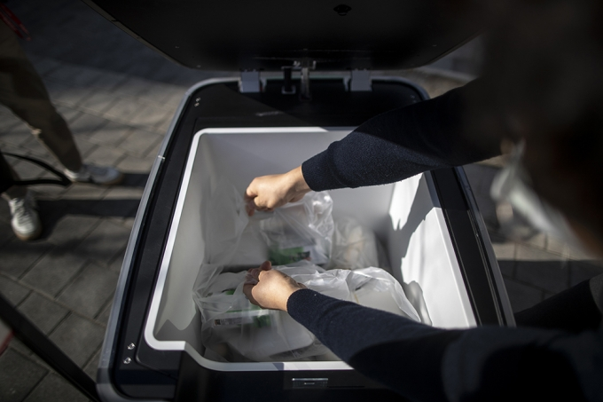
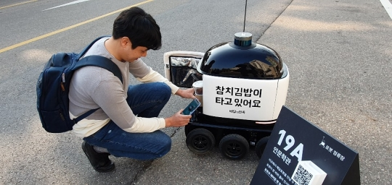
Hardware Design 2
Problem about existing robots
Fixed hardware and uncomfortable pose

Slide 7
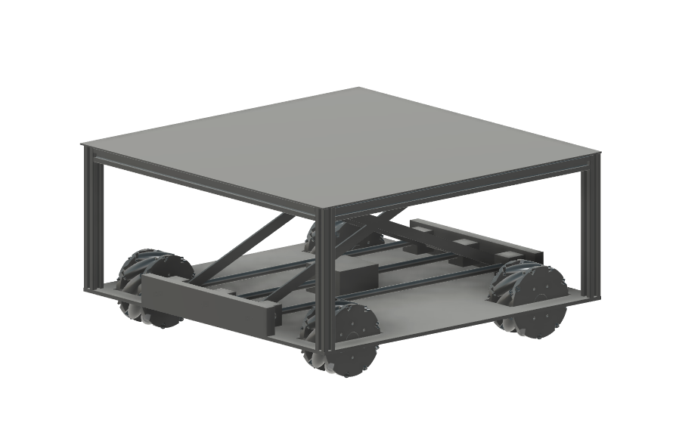
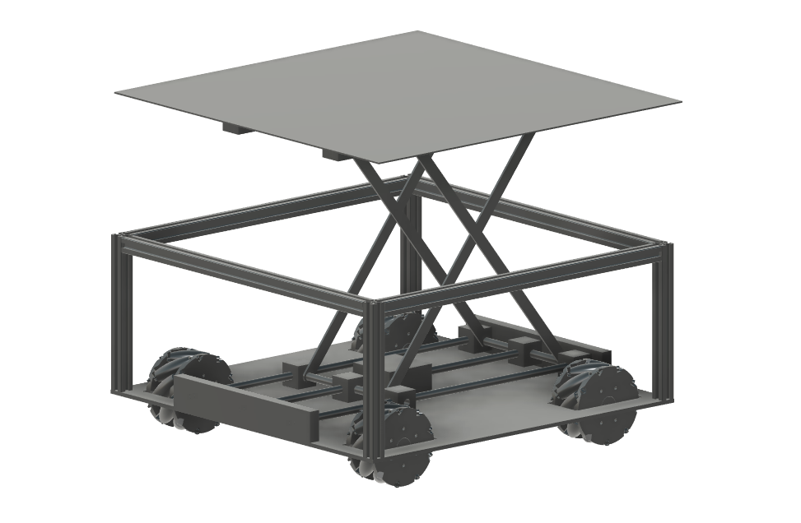
Hardware Design 2
Focus on just Delivery and Usability
Liftable container
While moving
Lift-down container
Sustain stability when moving
While put on / pick up
Lift-up container
More convenience for user
package
package

Slide 8
Scenario
Common Action
Stay and wait user at fixed location(and charging)
User inputs delivery command
Move to destination, complete mission and come back to station
For Design 1
No delivery command / At fixed time
Move around a floor and spray disinfectant on the doorknob
For Design 2
Detect human and check recipient when executing delivery
If detect recipient, hand over package without going destination and return

Slide 9
Q&A
Thank you

